Slide 1



Slide 2


Basic Tableau
Doubts are welcome
Entering to Advanced Tableau
Interview Prep
Advanced Tableau
Mock Certification Exam

Slide 3
Why Me ?
Comprehensive and accurate training
10+ Years of Experience
Trained faculty from industry
Mentoring support and Career Guidance
Industry Learning
Focus would be on 100% practical side of knowledge, and subjects
6 to 10 Industry Hands on Mini Projects
If class missed, go and look at the video
Certification and Interview Prep
Mock Tests which will help you get confidence to clear the GLOBAL Certification

Slide 4


What and Why Data Visualization and BI?

Slide 5
What and Why Data Visualization/Business Intelligence?
Why Data Visualization? (Exercise)
How many customers are there in each region?
What is the %age profit by Customer Segment?
What is the %age of customer by ship mode?
Which state has highest Sales across states?

Slide 6
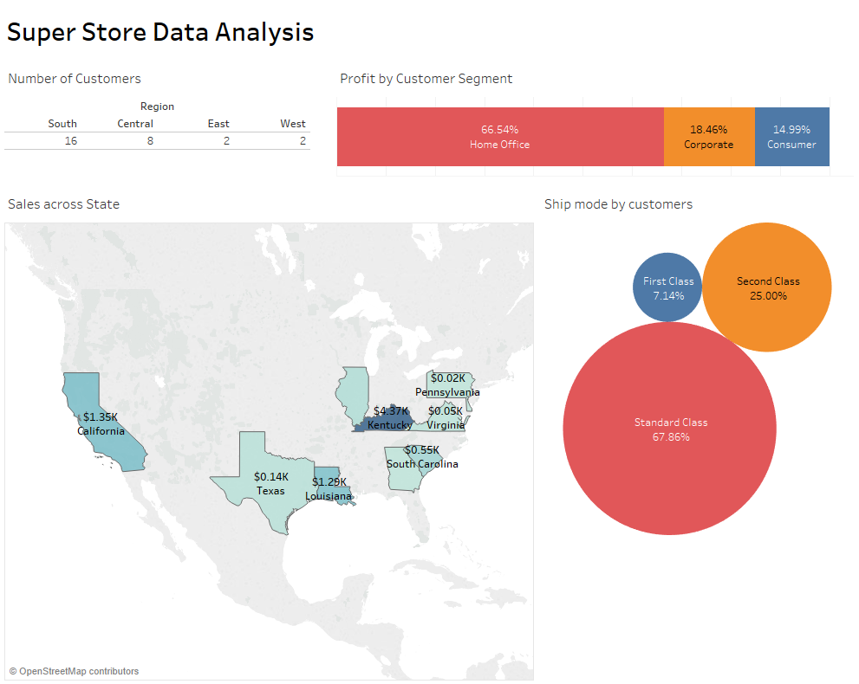
Why Data Visualization? (Exercise)
How many customers are there in each region?
What is the %age profit by Customer Segment?
What is the %age of customer by ship mode?
Which state has highest Sales across states?

Slide 7
Which industry requires Data Visualization?

Slide 8



Slide 9
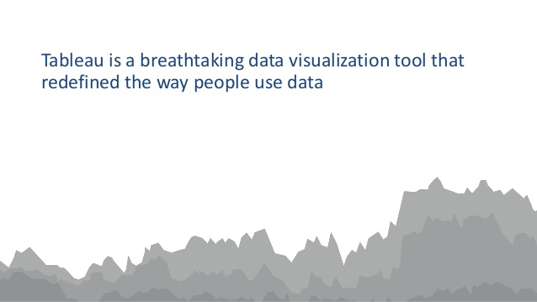
Swedish Medical shares quality metrics to improve care & save millions
Allrecipes, the world’s largest digital food brand, uncovers marketing trends with Tableau
PepsiCo cuts analysis time by up to 90% with Tableau
Engineers at payment processing company, Dwolla scale data infrastructure with Tableau
AmeriPride CIO discovers most profitable customers with Tableau
Tableau for small business: "Tableau makes the business I run and the life I lead possible.”
Workforce consulting, KellyOCG increases productivity by 25% & elevates talent to the next level with Tableau
Global network specialist, Ciena grows consulting business with analytics-as-a-service, powered by Tableau Online
Wells Fargo wrangles data from over 70 million customers to redesign customer banking portal
GoDaddy scales data governance on 13TB of data/day with Tableau
Rakuten: "Viewing bigger and more actionable data than ever"
LinkedIn empowers thousands of salespeople with Tableau, reducing customer churn

Slide 10

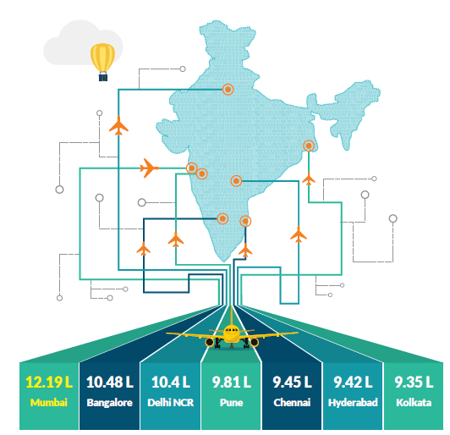
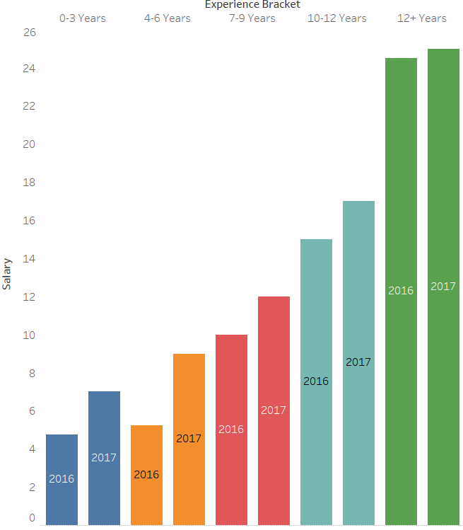

Slide 11
Tools available in Market for Data Visualization

Slide 12




and many more

Slide 13
Why Tableau?

Slide 14

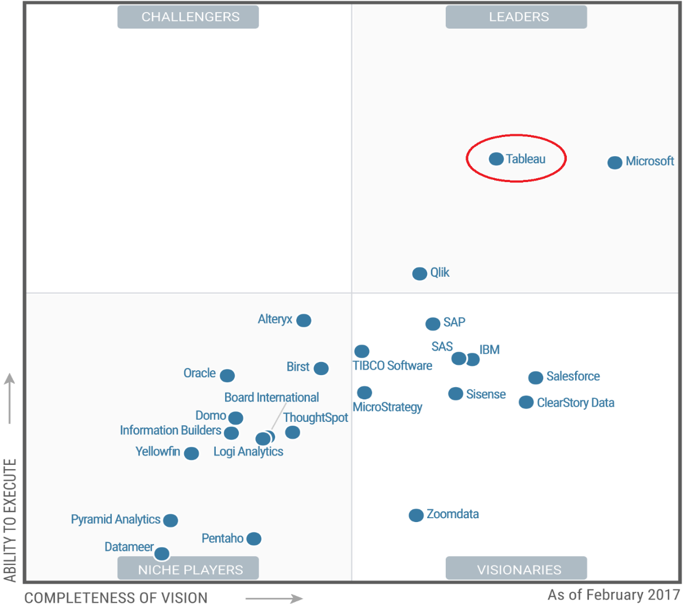
Gartner Magic Quadrant
Tableau is a Business Intelligence tool for visually analyzing the data.
Users can create and distribute interactive and shareable dashboards which depict the trends, variations and density of the data in form of graphs and charts.
Tableau can connect to files, relational and Big data sources to acquire and process data.
The software allows data blending and real time collaboration, which makes it very unique.
It is used by businesses, academic researchers and many governments to do visual data analysis.
It is also positioned as a leader Business Intelligence and Analytics Platform in Gartner Magic Quadrant.

Slide 15



Tool comparison
Description
Tableau is a data visualization, discovery and analysis tool that enables fast self-service capabilities for end users
Cost
$999 for Desktop and $1,999 for Desktop Professional
Tool Type:
Visualization
Market Presence
Verdict
Functionality
Usability
Data Connectivity
Security
Leading data visualization and exploration tool enabling fast discovery to insight capabilities for end users
Description
Microsoft’s PowerBI is a low cost cloud-based data discovery and visualization tools that offers a hybrid approach to store data on premise and visualize in the cloud
Cost
$9.99 user/month
Verdict
Tool Type:
Visualization
Functionality
Usability
Data Connectivity
Security
Market Presence
Low cost alternative that has the ability to offer integration with other Microsoft technologies. Limited PowerPivot integration.
Description
Regarded for its robust ETL capabilities and fine-tuned look and feel options, Qlikview is a formidable player in the BI market
Cost
$1,350 desktop license
Tool Type:
Visualization
Verdict
Functionality
Usability
Data Connectivity
Security
Market Presence
Associative data discovery engine and ability to integrate additional visuals and functionality via API differentiate Qlik from competitors

Slide 16
Tableau Features
Tableau provides solutions for all kinds of industries, departments and data environments. Below are the unique features which enable tableau handle so many diverse scenarios.
Speed of Analysis - As it does not need high level of programming expertise, any computer user with access to data can start using it to derive value from the data.
Self-Reliant - Tableau does not need a complex software setup. The desktop version which is used by most users is easily installed and contains all the features needed to start and complete data analysis.
Visual Discovery - The user explores and analyses the data by using visual tools like colors, trend lines, charts and graphs. There is very little script to be written as nearly everything is done by drag and drop.
Blend Diverse Data Sets - Tableau allows you to blend different relational, semi-structured and raw data sources in real time, without expensive up-front integration costs. The users don’t need to know the details of how data is stored.
Architecture Agnostic - Tableau works in all kinds of devices where data flows. So the user need not worry about specific hardware or software requirements to use Tableau.
Real Time Collaboration - Tableau can filter, sort, and discuss data on the fly and embed a live dashboard in portals like SharePoint site or Salesforce. You can save your view of data and allow colleagues to subscribe to your interactive dashboards so they see the very latest data just by refreshing their web browser.
Centralized Data - The tableau server provides a centralized location to manage all of the organization’s published data sources. You can delete, change permissions, add tags, and manage schedules in one convenient location. It’s easy to schedule extract refreshes and manage them in the data server. Administrators can centrally define a schedule for extracts on the server for both incremental and full refreshes.

Slide 17
What Tableau offers?

Slide 18
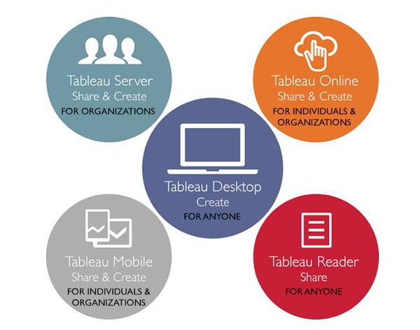

What Tableau Offers?

Slide 19
Important Links and details
Tableau Public
https://public.tableau.com/s/
Google Drive Link
Machine hardware requirement
Windows
Microsoft Windows 7 or newer (32-bit and 64-bit)
Microsoft Server 2008 R2 or newer
Intel Pentium 4 or AMD Opteron processor or newer
2 GB memory
1.5 GB minimum free disk space
1366 by 768 screen resolution or higher
Apple
iMac/MacBook computers 2009 or newer
OSX 10.10 or newer
5 GB minimum free disk space
1366 x 768 screen resolution or higher

Slide 20
Tableau Architecture and Scalability

Slide 21
Tableau File Types
File Type | File Extension | Purpose
Tableau Workbook | .twb | Tableau workbook files have the .twb file extension and are marked with the workbook icon. Workbooks hold one or more worksheets and dashboards.
Tableau Packaged Workbook | .twbx | Tableau packaged workbooks have the .twbx file extension and are marked with the packaged workbook icon. Packaged workbooks contain a workbook along with any supporting local file data sources and background images. This format is the best way to package your work for sharing with others who don’t have access to the data.
Tableau Data source | .tds | The details of the connection used to create the tableau report are stored in this file. In the connection details it stores the source type(excel/relational/sap etc.) as well as the data types of the columns.
Tableau Packaged Data source | .tdsx | This file is similar to the .tds file with the addition of data along with the connection details.
Tableau Data Extract | .tde/.hyper (After 10.5) | Tableau data extract files have the .tde file extension and are marked with the extract icon. Extract files are a local copy of a subset or entire data source that you can use to share data, work offline, and improve database performance.
Tableau Bookmark | .tbm | Tableau bookmark files have the .tbm file extension and are marked with the bookmark icon. Bookmarks contain a single worksheet and are an easy way to quickly share your work.
Tableau Preferences | .tps | This file stores the color preference used across all the workbooks. It is mainly used for consistent look and feel across the users.
Tableau Map Source | .tms | If you want to save custom maps from Mapbox or save the maps from the WMS server for future use. Further, another reason when you might save a map as a .tms is if you wish to share your custom maps with colleagues and clients. http://ows.terrestris.de/osm/service
Tableau Data Types
Data Type | Description | Example
STRING | Any sequence of zero or more characters. They are enclosed within single quotes. The quote itself can be included in a string by writing it twice. | 'Hello'
 |  | 'Quoted' 'quote'
NUMBER | These are either integers or floating points. It is advised to round the floating point numbers while using them in calculations. | 3
 |  | 142.58
BOOLEAN | They are logical values. | TRUE
 |  | FALSE
DATE & DATETIME | Tableau recognizes dates in almost all formats. But in case we need to force tableau to recognize a string as date then we put a # sign before the data. | "02/01/2015"
 |  | "#3 March 1982"
GEOGRAPHIC | Tableau recognizes data columns like Country, State, City and tag is as Geographic dimension by default | India, Maharashtra, Mumbai

Slide 22
Business Problem 1 – My First Bar Chart

Slide 23

Business Problem:
It's End of financial year and its time for annual bonuses...
The Store operates in three regions and only the top performing employee in each region qualifies for a bonus. Find out which three employees are eligible to get bonuses for this year?
Employees are measured on total sales ($)
Also You need to Analyze about those employees who were not able to perform well in all the three regions.
The Manager does not have Tableau so what all ways you can share your report to tell about your Analysis
What we will learn today
What is our goal?
What we offer?
Future of Tableau and Salary bracket
What is Business Intelligence and Data Visualization?
What is Tableau and its competitors?
Why Tableau and its features?
Where we require Tableau?
Products Tableau offers
Tableau Architecture
Tableau Scalability
Different File types in Tableau
Different data types in Tableau
What is an extract and live connections?
Database filters in Tableau
Spending time with Tableau
How to create a bar chart
Formatting in Tableau
Exporting the image of visualization and pdf from Tableau

Slide 24
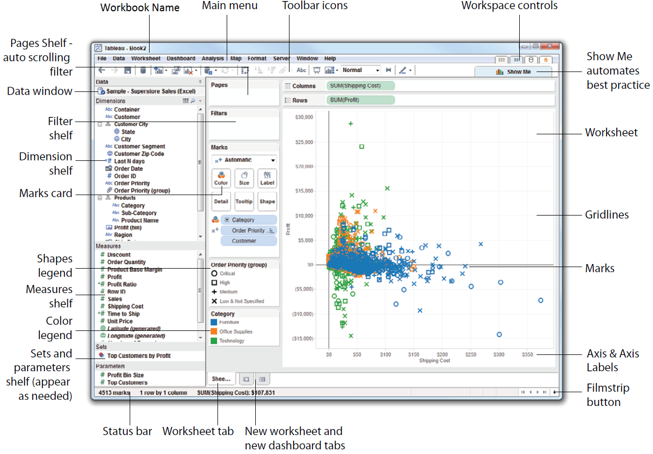
Tableau Tool Overview

Slide 25

Tableau Desktop Certification

Slide 26
Reality Check

Slide 27
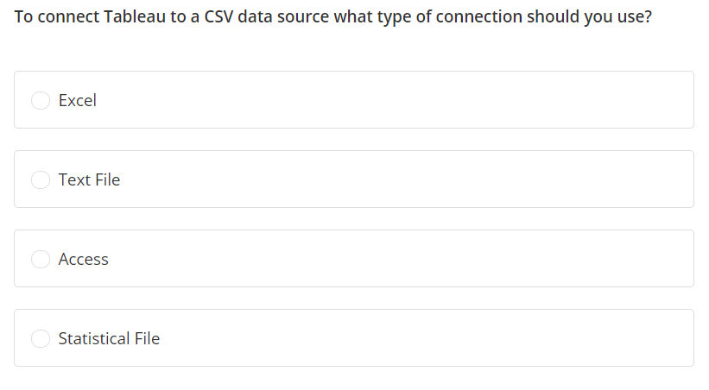

Slide 28
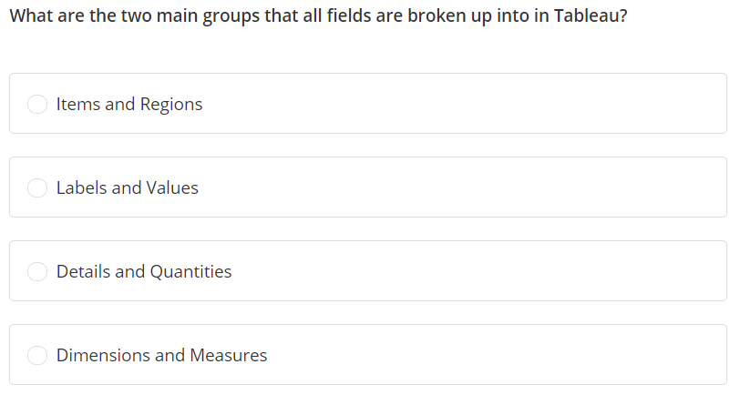

Slide 29
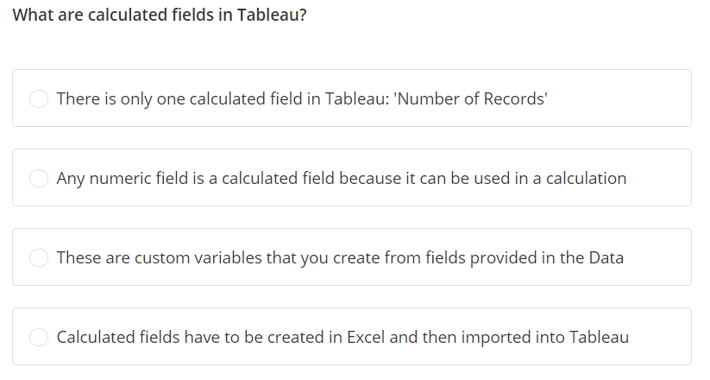

Slide 30
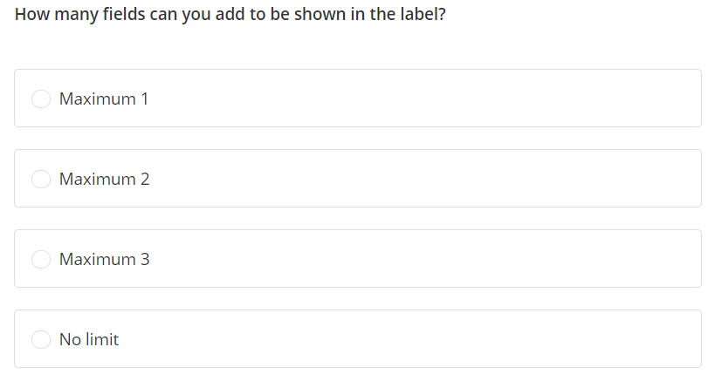

Slide 31
